Slide 1
.NET Brief Introduction
Huanqi Cao @ TUNA
3/17/2018

Slide 2
Where is .NET?
What can it do?
Platform and Language supports

Slide 3
Platform support
.NET Core on Windows, Linux, macOS, FreeBSD and NetBSD.
  ASP.NET Core, a highly-efficient Web framework;
  UWP .NET API part.
Mono by third-party with cross-platform support also.
  Xamarin for mobile app development including Android, iOS and Windows Phone;
  Unity for game development.
.NET Framework on Windows.
  Not going to mention too much.

Slide 4
Language Support
C#.
  Great language (at least many much better than Java XD)
F#.
  A functional programming language.
VB.NET.
  Dead (Nope
PowerShell.
  In PS you have full access to .NET APIs excluding those with generics.

Slide 5
The .NET Stack
A General Overview of the whole Eco-Sys.

Slide 6
ECMA-335:
Common Language Infrastructure
This includes a Common Type System, a Common Intermediate Language (stack machine model, object oriented) and many others.
CIL is much more powerful than IRs like Java Bytecode:
  Value-types (including struct)
  On-stack allocation
  Fixing a memory piece towards GC (and thus pointer usage in unsafe mode)
  and so on.

Slide 7
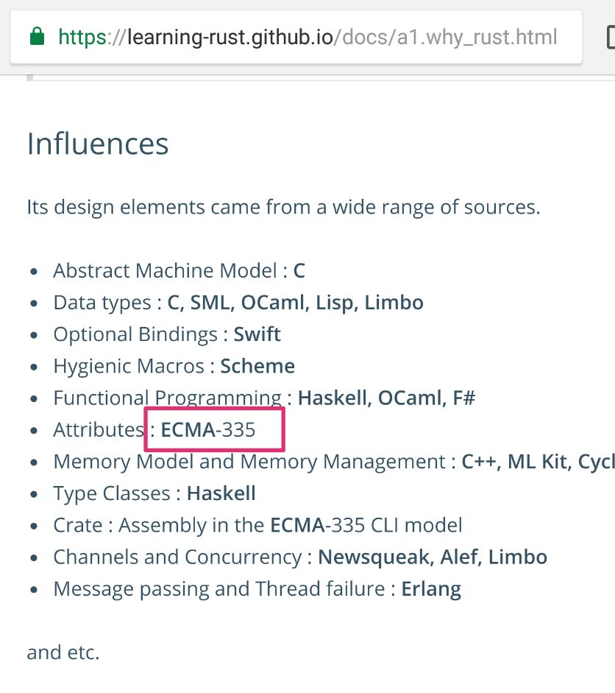
“NO .NET PLZ”
A small piece in the Learning Rust guide.

Slide 8
The Real-World Platforms
This currently includes .NET Core, Mono and .NET Framework.
A platform is responsible of executing CIL assemblies, providing platform-dependent runtime services and APIs specified by .NET Standard.
Such a platform don't necessarily JIT the IL to native at runtime; AOT is supported on multiple platforms.

Slide 9
So What’s a Platform Like?
Take .NET Core as an example, it mainly consists of those components:
  CoreCLR. This is the most basic part of the platform, a.k.a. the runtime, providing JIT/AOT engine and platform-dependent internal things.
  CoreRT (WIP). An alternative runtime to .NET Core, generating .NET CIL into executables, C++ codes and even WebAssembly.
  CoreFX. This is where things like System.Collections lies. Those implementations depends only on CoreCLR and should be able to get compiled and run on any other .NET Core compliant runtime, like CoreRT and Mono.

Slide 10
.NET Standard
The .NET Standard is a formal specification of .NET APIs that are intended to be available on all .NET implementations.
Also, it's itself a available target platform when building any .NET libraries.
  For example, if a product provides both Web and mobile app implementation:
    Develop the Web server with ASP.NET Core in MVC model
    Develop the mobile app with Xamarin in MVVM model
    And share the same model library, which targets at .NET Standard (binary compliant).

Slide 11
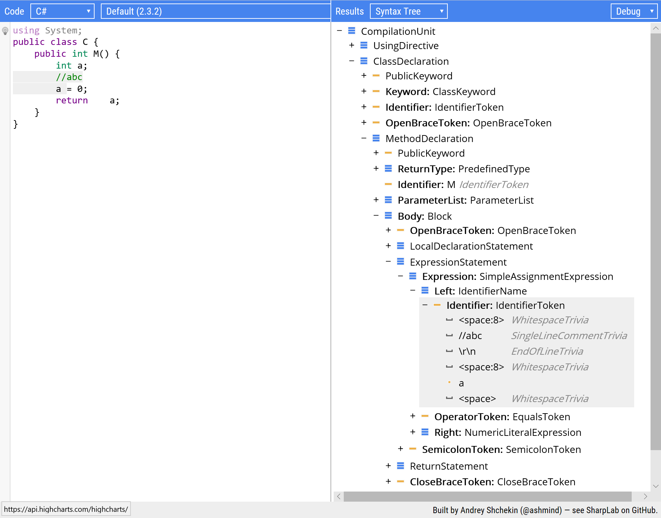
Compilers
Compilers in .NET is like compiler frontend in the concept of LLVM, etc.
  They compile languages that follow CTS to CIL, assemble and pack them into assemblies and modules, which is expected to execute on targeted runtime(s).
Roslyn is somehow interesting it self.

Slide 12
Package Manager
.NET has its own package manager NuGet.
This PM is responsible of delivering:
  any libraries;
  API extension packages (like System.Reflection on .NET Standard target);
  and even compilers used in building your solution.

Slide 13
Project System based on MSBuild
This is a declarative project system based on XML file format, with highly customizable features and multi-language/compiler/runtime support.
MSBuild also supports native compilation; it's the base of Visual Studio solution system.

Slide 14
Some .net Philosophies

Slide 15
Language & Runtime separated
New language features are implemented through:
  Add new codegen functionality without changing in any other parts. Features like async-await are added in this way. (pure-sugar)
  Request new Runtime library. This will add new components in runtimes, and even new API in .NET Standard (of course, in next version). Features like tuples are added in this way. (sugar to library)
Runtimes are developed independently. This guarantees that the runtime is really for "Common Language".

Slide 16
Runtime feature decoupling
With multiple runtimes, it is expected to share codes in binary form across runtimes.
User may specify target as .NET Standard and add reference to wanted API extension package in NuGet gallery.
  All runtimes with that API implemented will be able to get this library executed.

Slide 17
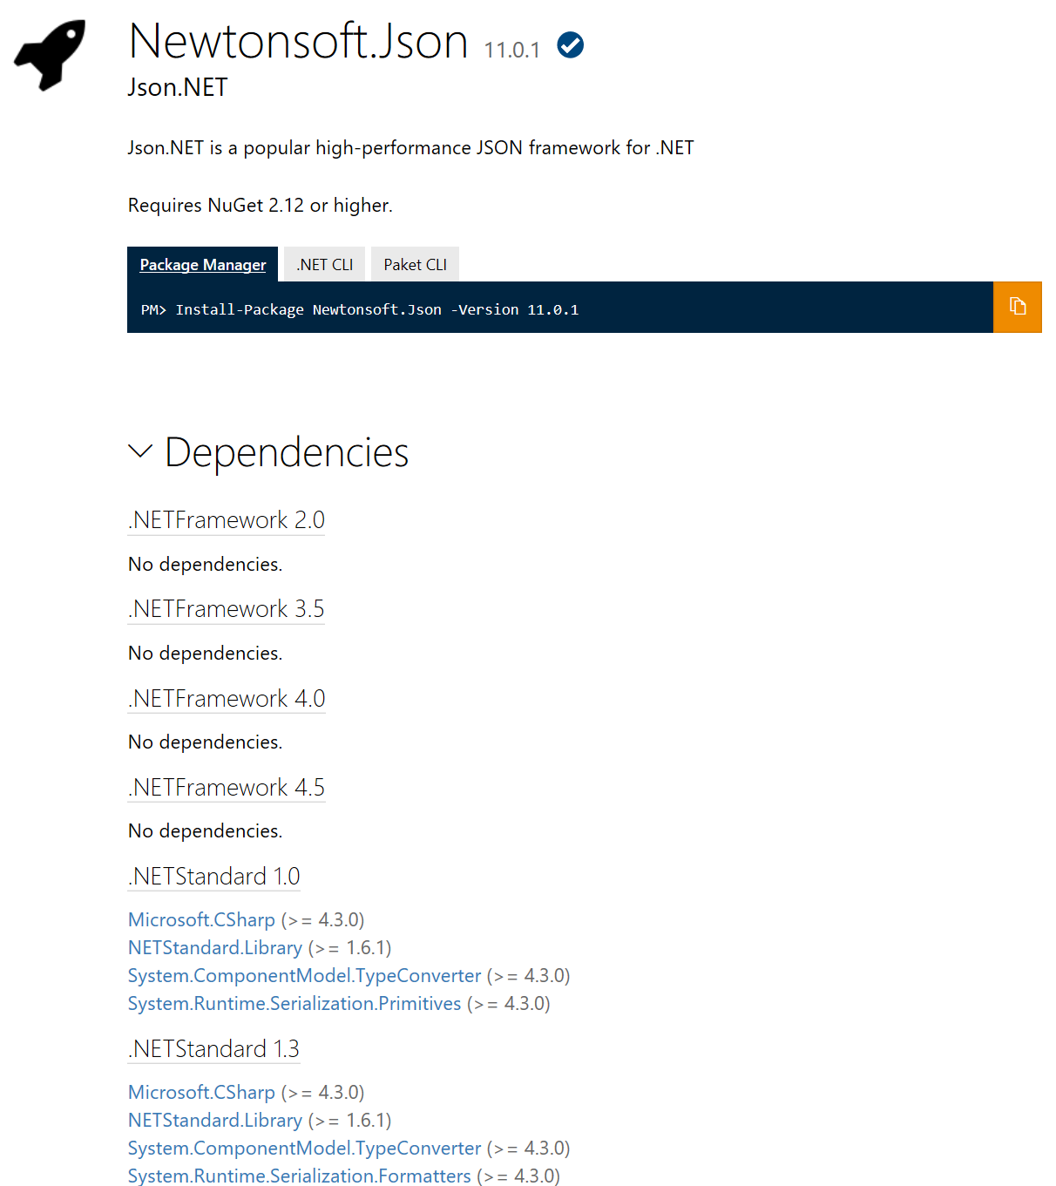
Newtonsoft.Json
A good example on library targeting at a wide range of runtimes.

Slide 18
And… The Community.
All on GitHub.

Slide 19
And That’s All.
Thanks!

